Slide 1


ANALYSIS OF COSMETIC PRODUCT REVIEWS BY
NYKAA
By Gayathri Mattaparthi & Liya Kalan

Slide 2
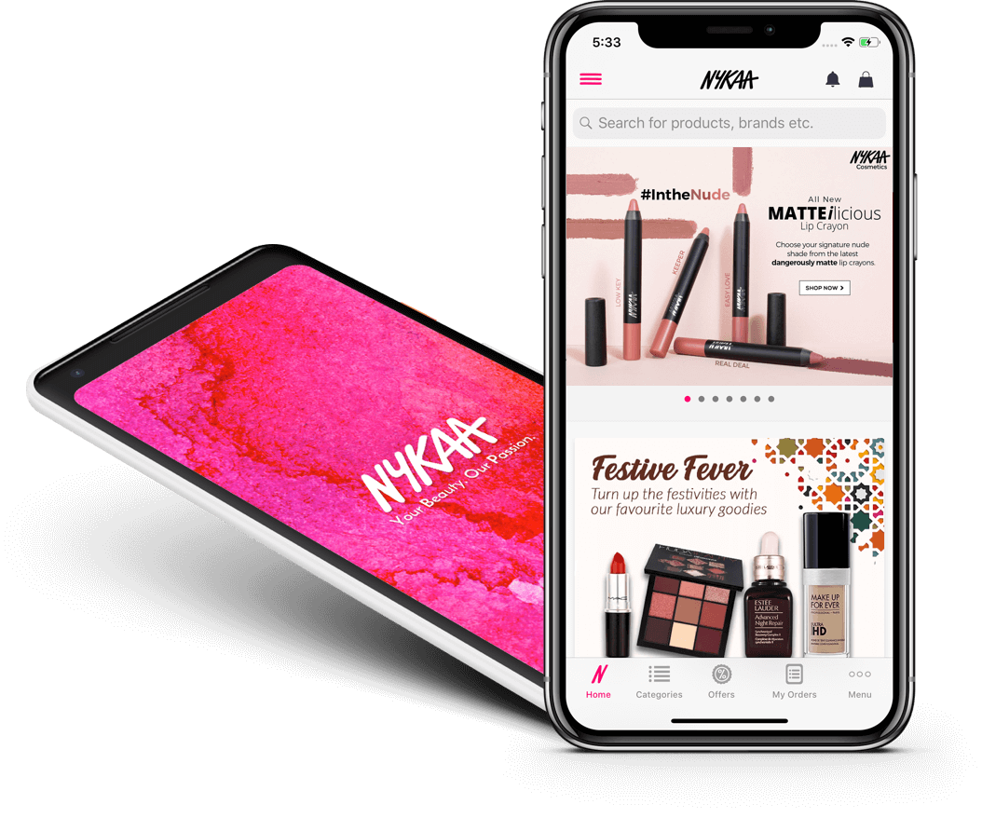

INTRODUCTION
Indian e-commerce company
Founded in April 2012
Range of wellness and beauty products
Website, App and 84 offline stores

Slide 3
MOTIVATION
The primary aim of the proposed project is to create a framework that can be used to comprehend the different category patterns of Nykaa product reviews. As a result, a data analytic investigation will be given in order to identify the connected components in the collection.

Slide 4
DATASET
Data
18 columns
Variables
Product Id
Product Price
Retailer
Product Brand
Product Rating
…
KAGGLE • Nykaa Cosmetic Products Review 2021

Slide 5
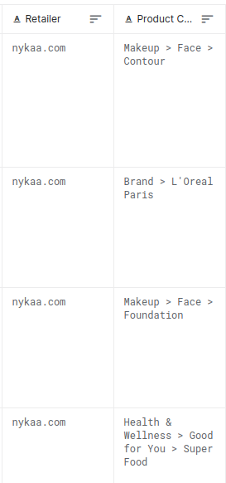
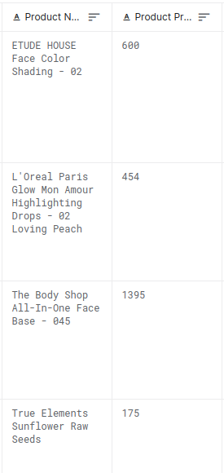
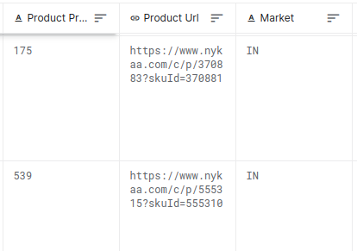
.CSV

Slide 6
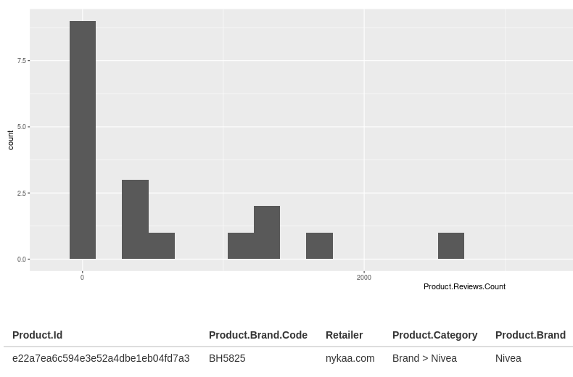
TOOLS
Libraries
Shiny App
dplyr
ggplot2
ShinyApp has been created for the work. Required information is selected for the particular task and based on that, information, histogram and data driven filtered data table has been represented to understand and observe the data thoroughly.

Slide 7
DEMO

Slide 8
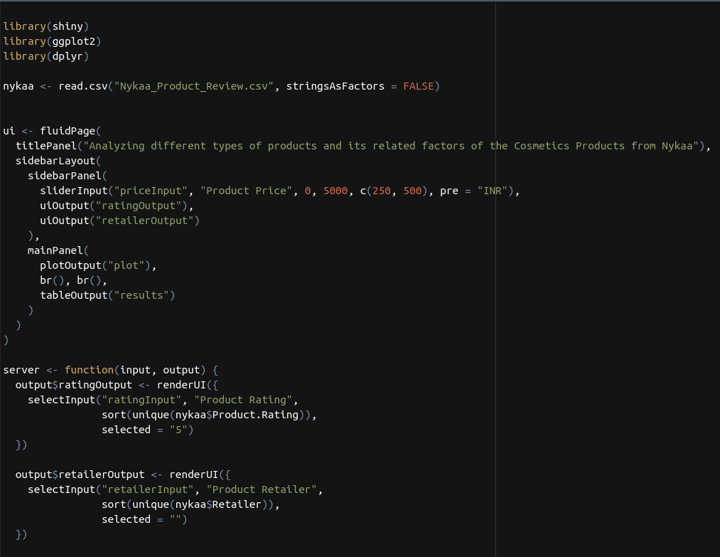

Slide 9
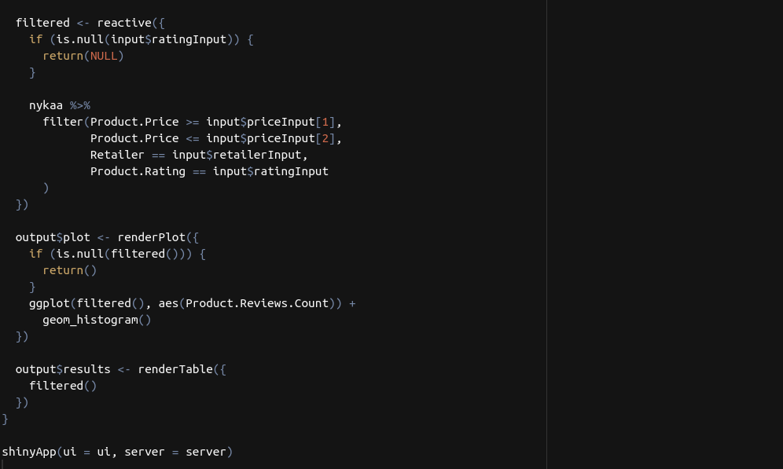

Slide 10
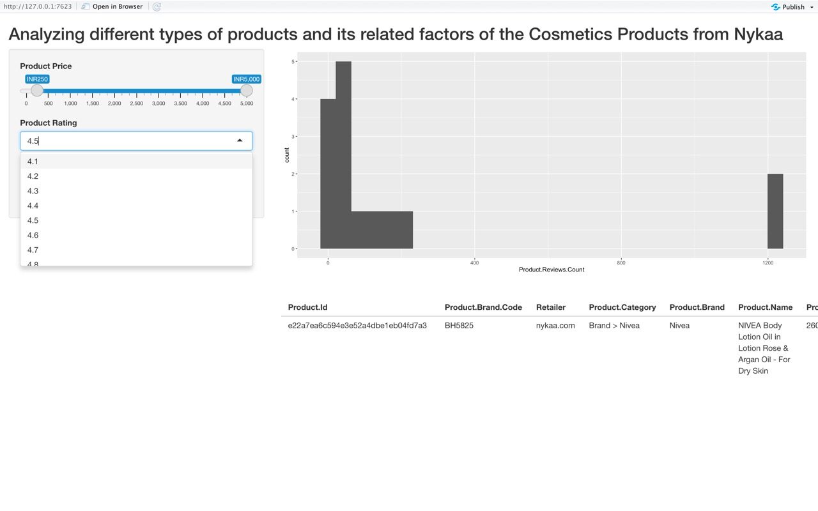

Slide 11
Thank You

